Slide 1

medical insurance system

Slide 2
Team Members:
-Zeyad Helmy Ramadan 320210294
-Marwan Mohamed Kassem 320210296
-Mohamed Tarek Fawzy 320210280

Slide 3
Benefits of Blockchain in Medical Insurance
Security and Privacy
Transparency and Trust
Reduced Fraud
Efficiency in Claim Processing

Slide 4
Key Technologies
Solidity:
Smart contract programming language
React:
Front-end library for building user interfaces
Node.js:
JavaScript runtime for server-side development
Ganache:
Personal blockchain for Ethereum development

Slide 5
System Architecture
Overview Diagram:
User Interface (React)
Smart Contracts (Solidity)
Backend (Node.js)
Blockchain Network (Ganache)

Slide 6
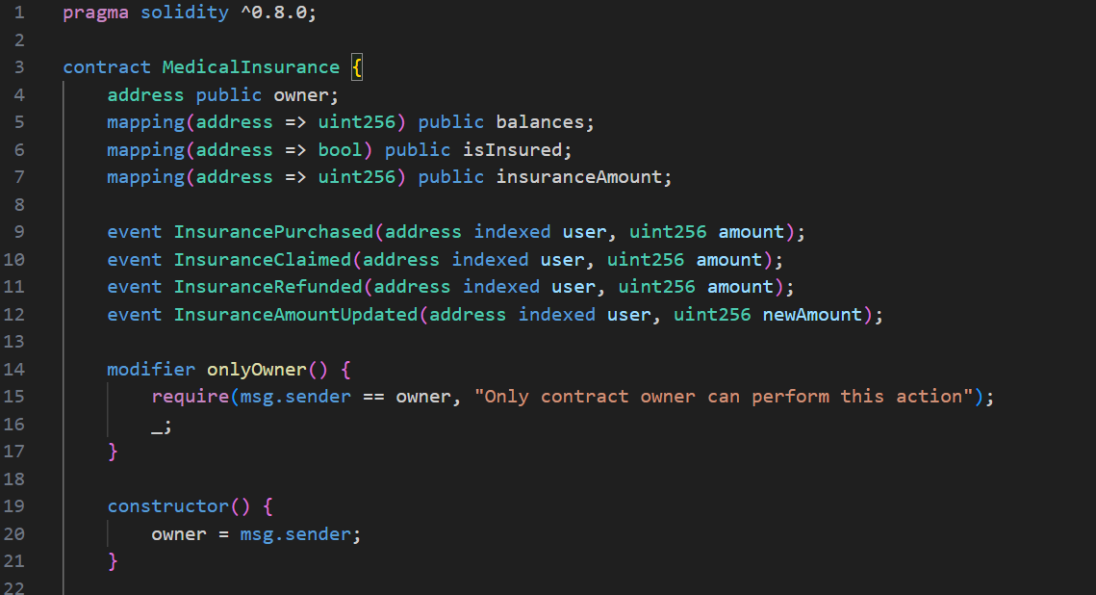
Smart Contract Development with Solidity

Slide 7
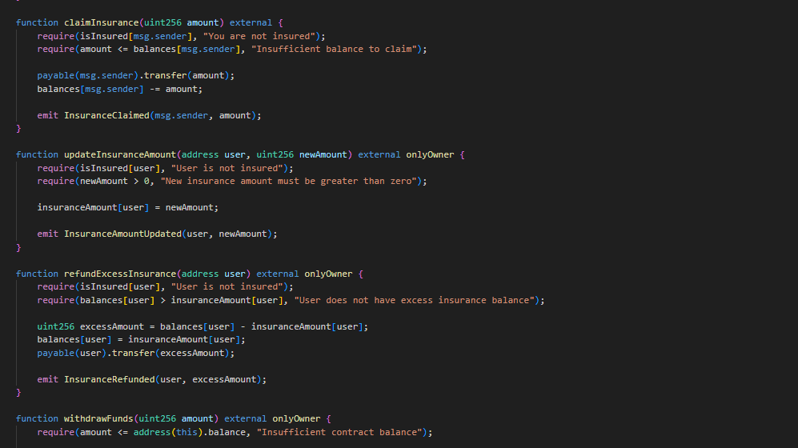

Slide 8
Front-End Development with React
Setting Up React:
Create a React app
Install necessary packages (e.g., web3)

Slide 9
Setting Up Ganache
Installation and Configuration:
Download and install Ganache
Setting up a local blockchain
Connecting to Ganache:
Using Ganache CLI or GUI
Accessing accounts and deploying contracts

Slide 10
Integrating All Components
Workflow:
Deploying smart contracts using Truffle or Hardhat
Interacting with contracts via Node.js
Building the UI in React
Example Interaction Flow:
User requests a policy via React frontend
Request is processed by Node.js backend
Smart contract function is called to create a policy

Slide 11
Challenges and Solutions
Scalability
User Experience
Regulatory Compliance
Technical Complexity

Slide 12
Conclusion
Summary of Key Points:
Blockchain’s role in transforming medical insurance
Technical implementation overview
Potential and future scope

Slide 13
Thank You

